Slide 1


Library Managemnt System

Slide 2
Team Names
Omar mohamed
Fathy Ayman
Ahmed ibrahim
Ahmed Hani
Mahmoud Desoky
Abanob Emad

Slide 3
Introduction
The Library Management System with ASP.NET Core is designed to streamline the process of managing a library’s day-to-day operations. This system helps track book checkouts, returns, and penalties for late returns. It also provides a search feature for available books and manages member information, enabling users to easily borrow and return books. The platform leverages modern web technologies to deliver a user-friendly interface for both librarians and members. By implementing this system, libraries can enhance their operational efficiency and improve the user experience.

Slide 4
Key Features:
Book Management: Librarians can add, view, and manage book information such as title, author, genre, and availability status.
Member Management: The system allows for the registration and management of member information, including contact details and borrowing history.
Checkout and Return System: Librarians can record book checkouts by members, including due dates, and process returns while tracking overdue penalties.
Penalty Calculation: The system automatically calculates penalties for late returns based on the number of overdue days.
Book Search: Search and filtering functionalities help librarians and members find available books by title, author, or genre.
Member Portal: A member-specific portal allows users to view their borrowed books, due dates, and any outstanding penalties.
User Authentication: Secure login and role-based access control for librarians and members to ensure privacy and system integrity.

Slide 5
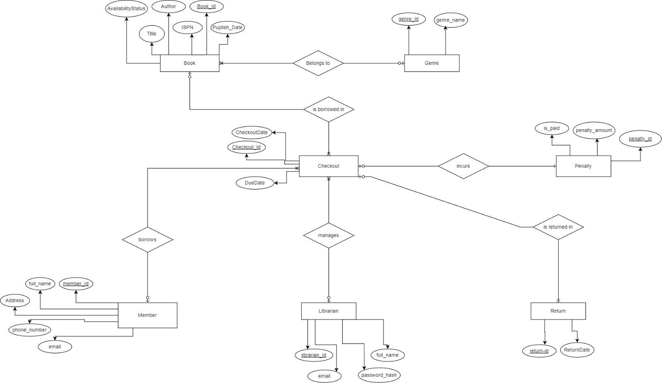
System Design : ERD

Slide 6

Technology Stack
ASP.NET Core: A powerful cross-platform framework for building web applications and APIs, serving as the backend for processing transactions.
Entity Framework: An Object-Relational Mapper (ORM) that simplifies database access by allowing developers to work with data using C# objects.
SQL Server: The relational database used to store book details, member information, and transaction data like checkouts and returns.
MVC (Model-View-Controller): A design pattern that separates the application into three interconnected components, allowing for better organization of code.
HTML/CSS/JavaScript: Used for designing the user interface and ensuring a responsive, user-friendly experience on the web.
User Authentication: ASP.NET Core Identity is utilized to manage authentication and authorization for both librarians and members.

Slide 7

Demo
Admin View

Slide 8
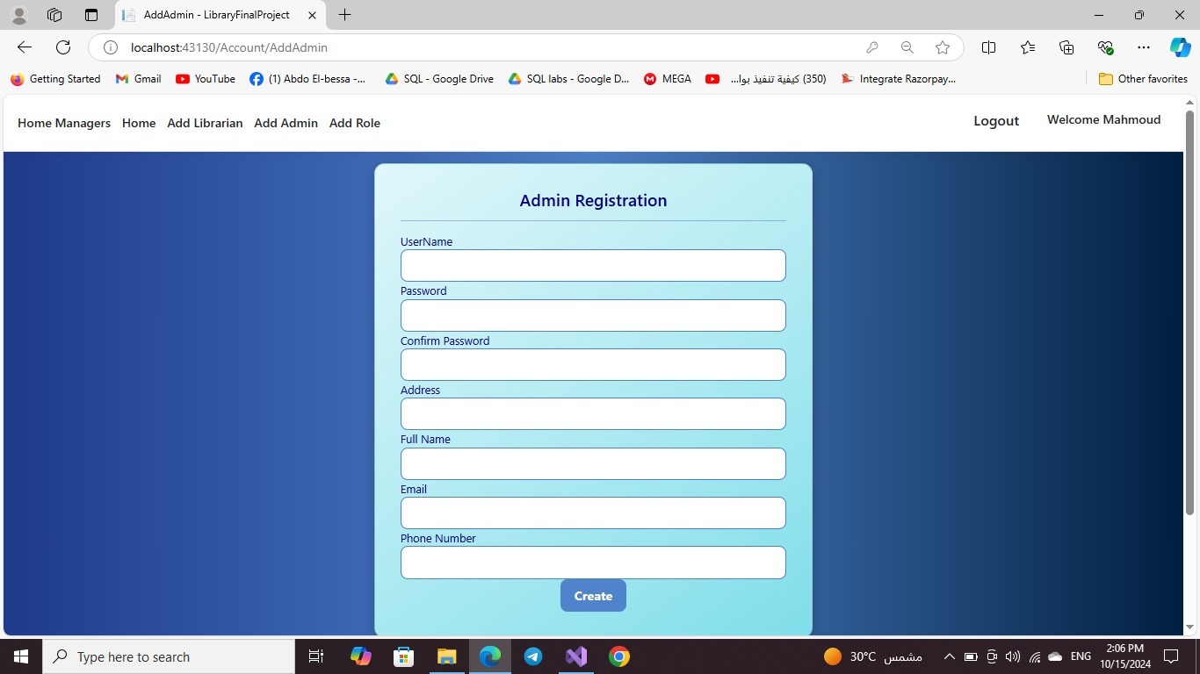



The registration page to enable admin to create new account on the website by adding “name,password,address,phone number and gmail .

Slide 9
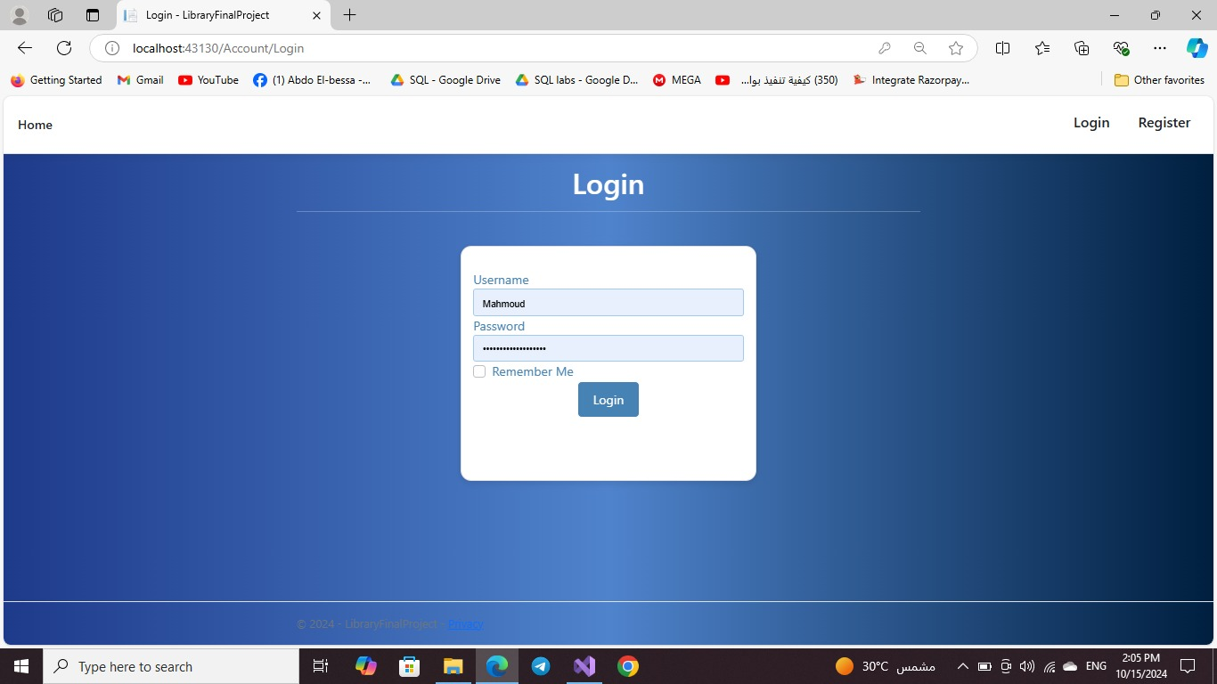
After the admin created the account he can log in from the login page on the wesite and he can save it “Remember Me” for the next login times .

Slide 10
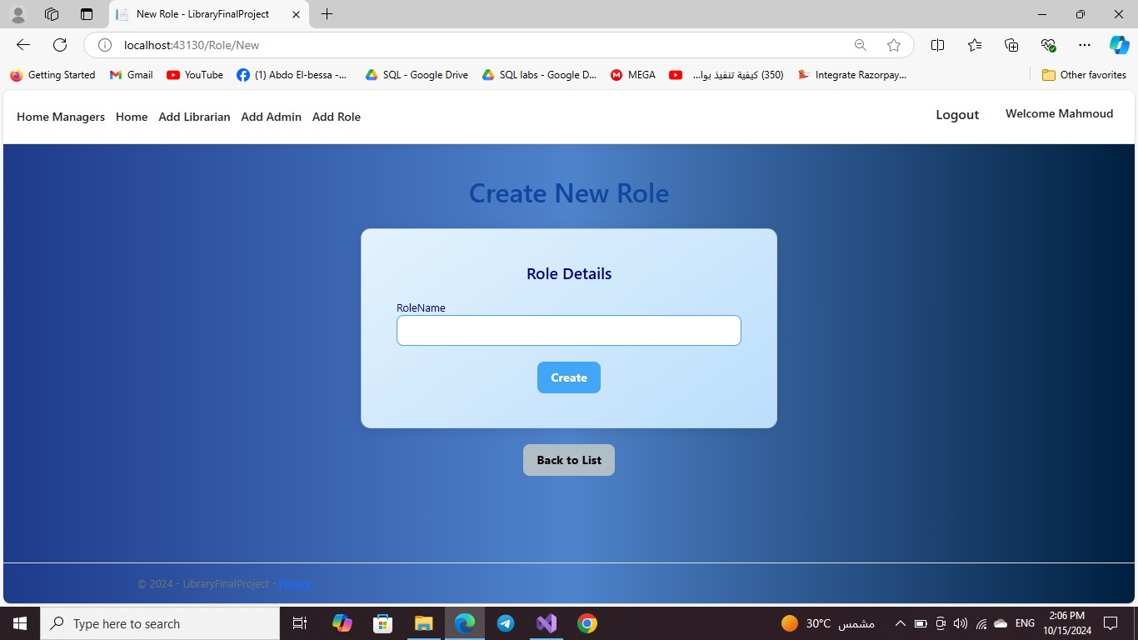
From this page you can create the roles for the persons who use this website like “adim ,librarian,user,etc”to give them the Appropriate role .

Slide 11
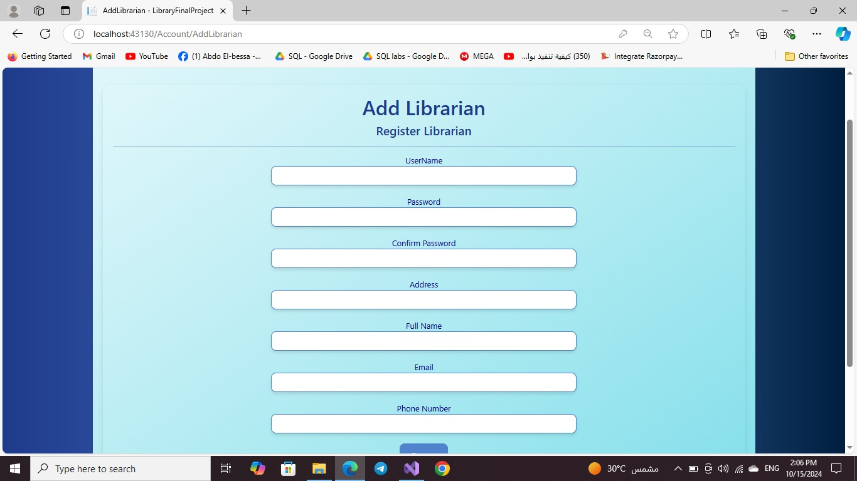
And from this page you can add the librarian of the library to make him do his role as managing the oprations of books on the website

Slide 12
Demo
Librarian view

Slide 13
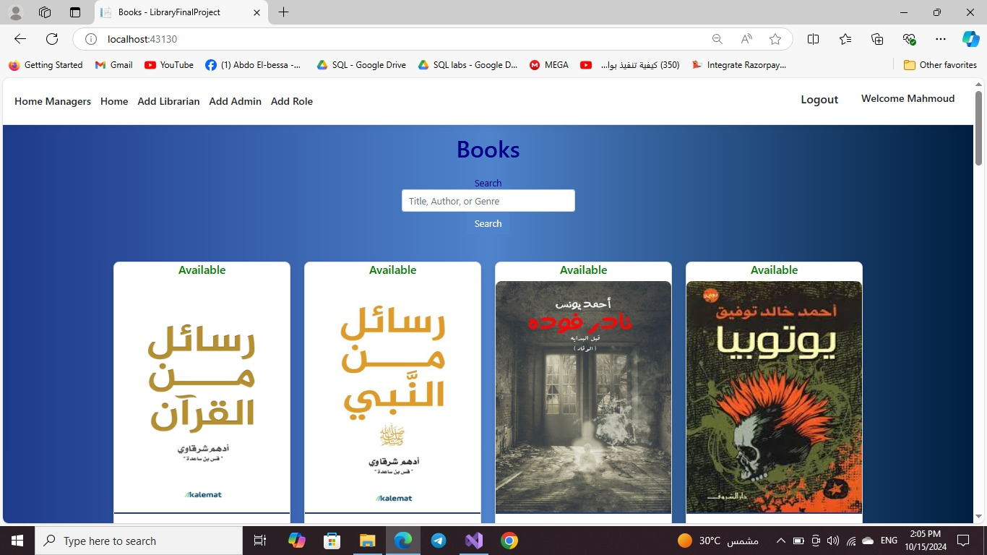
After you log into the website here it shows the most rated and borrowed books by the users of the library .

Slide 14
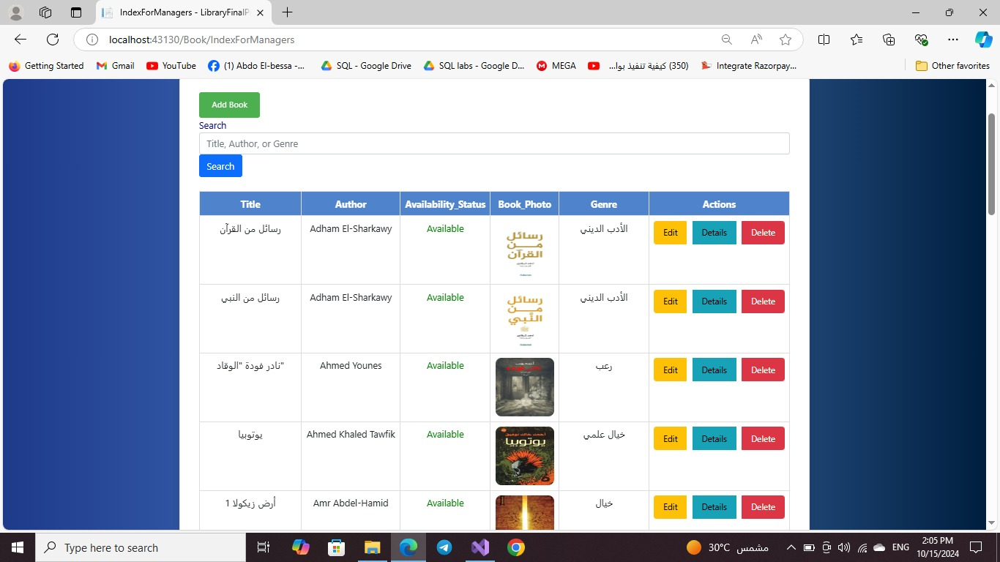
This page shows the available books of the library with the details of the book and also there is an option to add new book or search for the book by “title,author or genre” or do to any other actions .

Slide 15
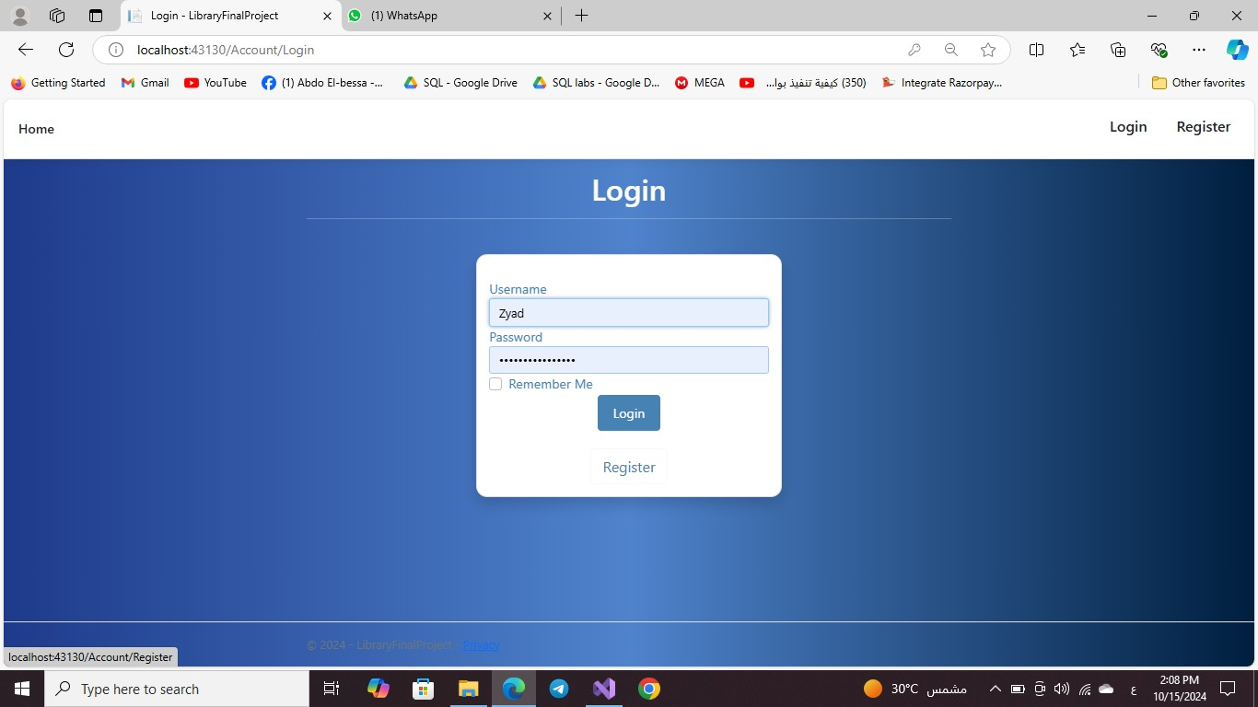
This is a different user with a different roles to enable him to do many other options in the library .

Slide 16

This page display the most rated and borrowed books but for a different user with different roles .

Slide 17
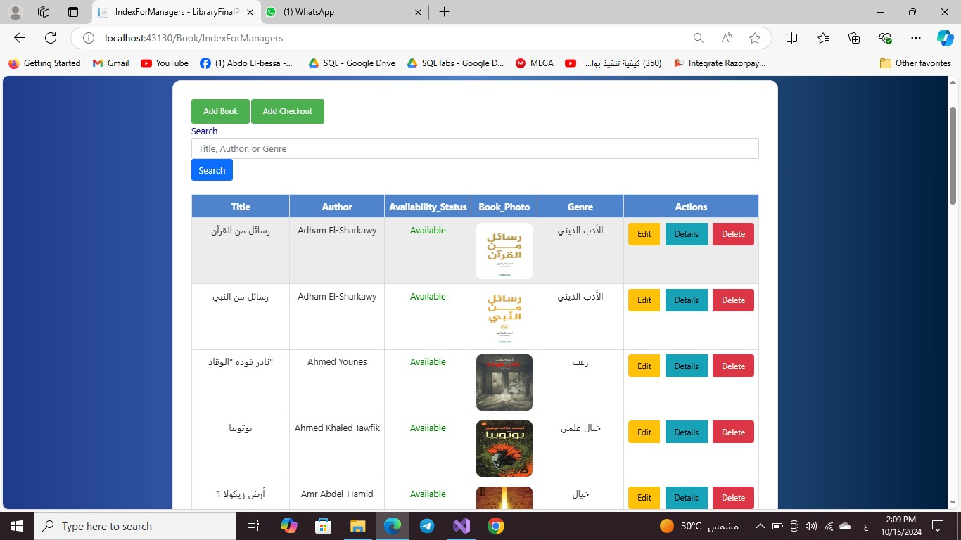
This page shows the available books but for a different user with a different roles on the website .

Slide 18
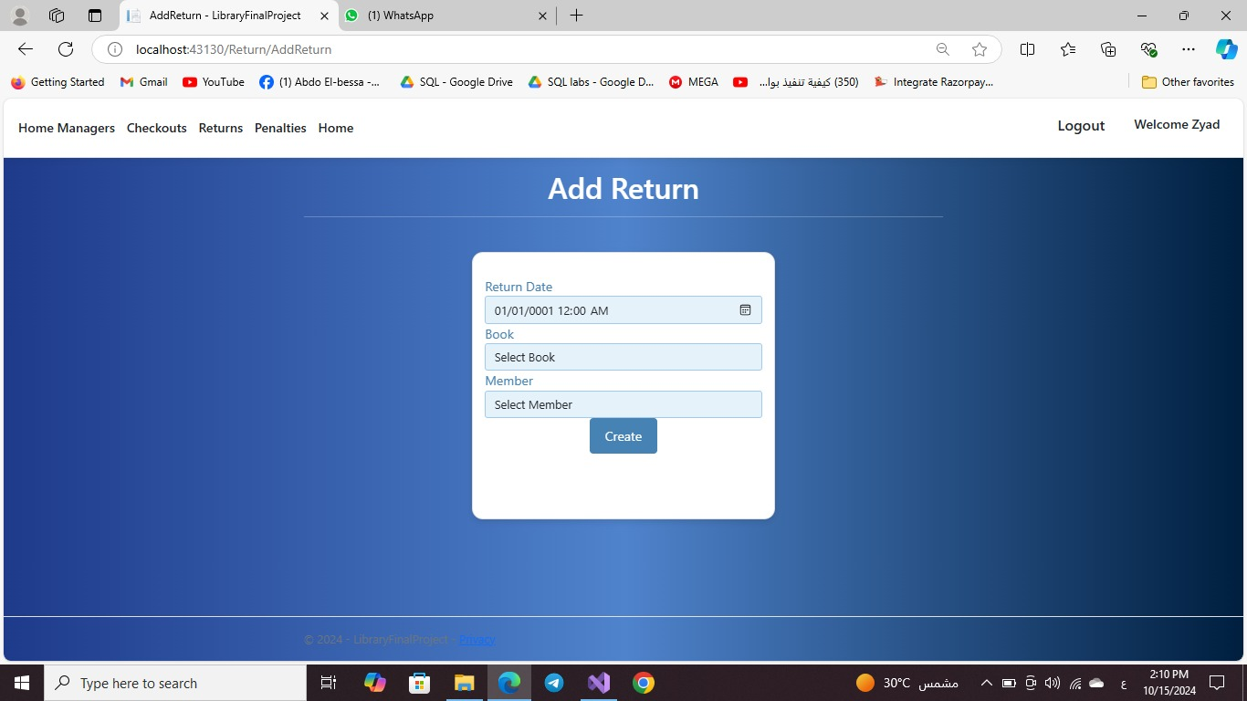
In this page the user select the book that he wants to borrow , the selected member and he should add the return data .

Slide 19
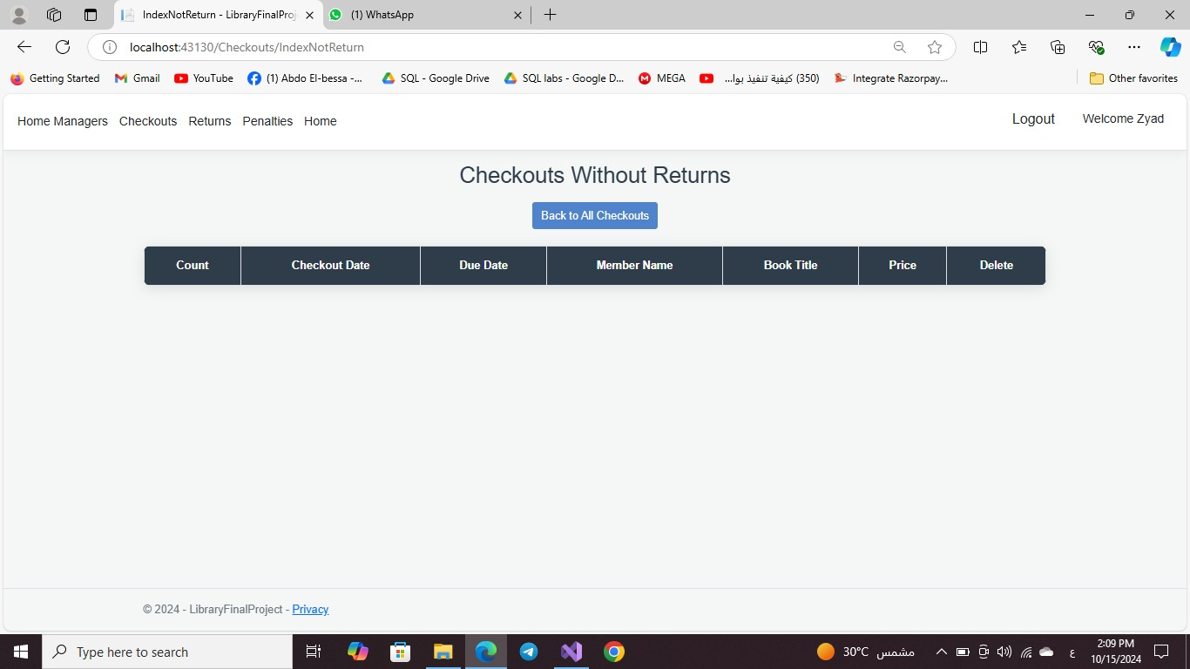
In this page enables to checkout for all books if any books are’t returnrd on the Scheduled date .

Slide 20
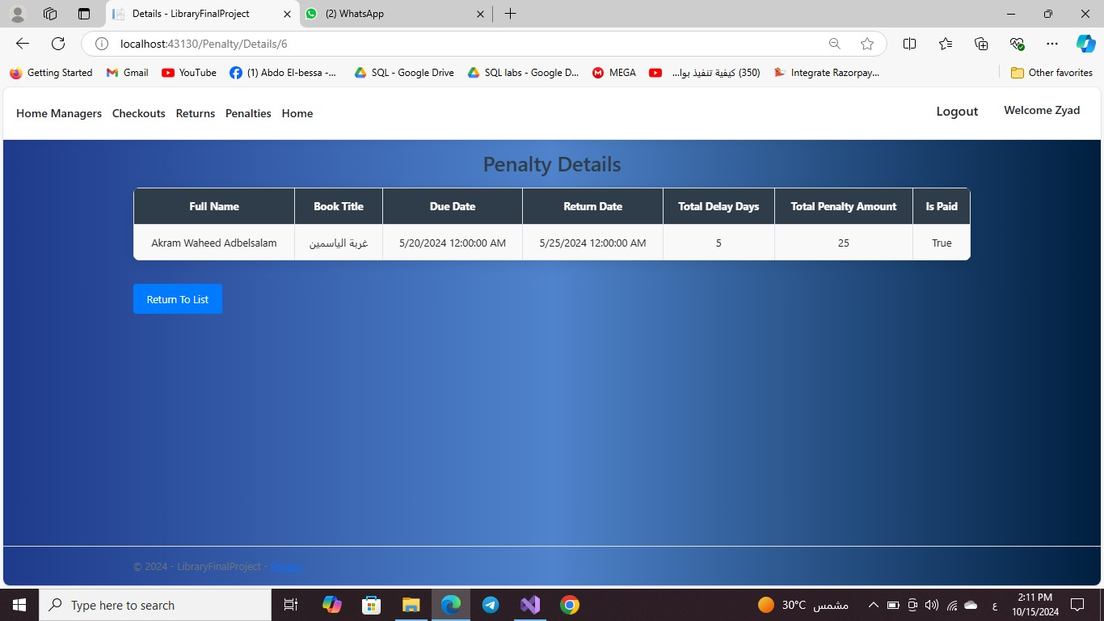
This page shows the penalty and its details that will be applied if the user didn’t return the books that he borrowed on the Scheduled date .

Slide 21
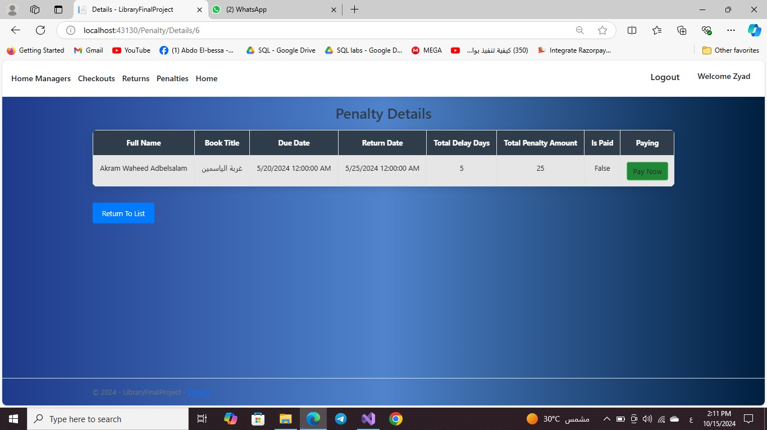
The is the penalty page but the Difference here is the penalty the user can pay it from the payment section .

Slide 22
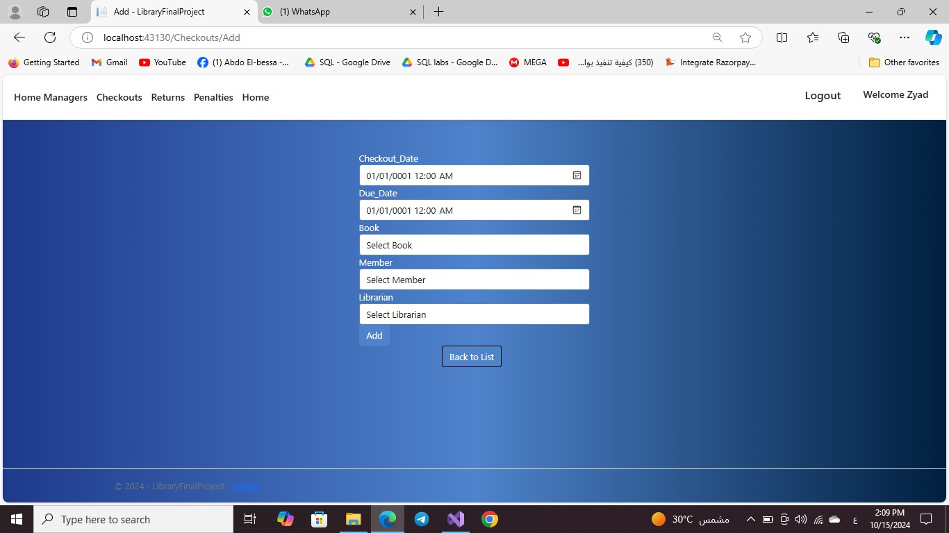
This page enable the user to enter the borrow details by adding the following data “checkout_date,due_date,the book ,the member and the librarian ” .

Slide 23
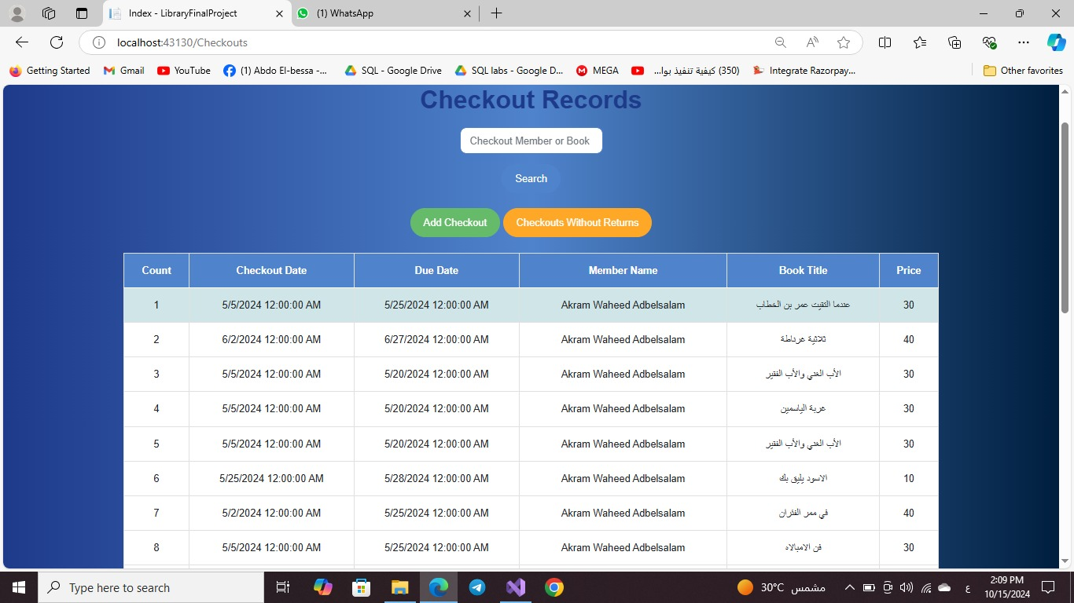
This page shows the checkout records with its details like “ book title , member name , due date ,checkout date,count and the price ” and also enables to do search for any checkouts members or books .

Slide 24
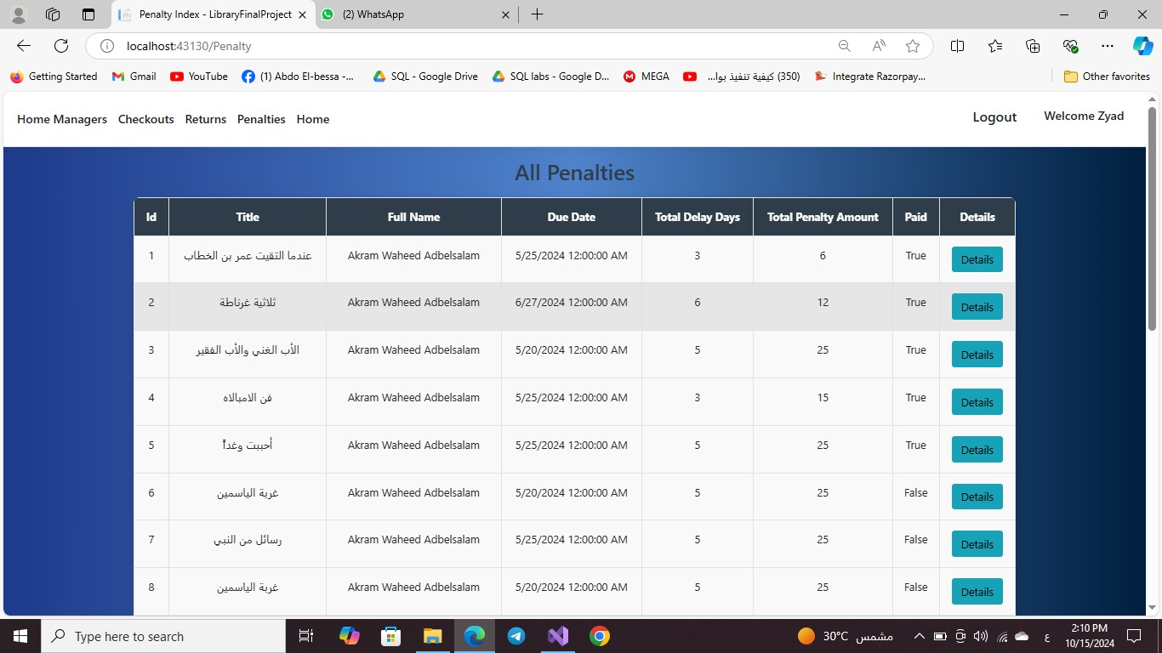
This page display all of the penalties with details that have been applied to all members with the statue and all details

Slide 25
Demo
Member View

Slide 26
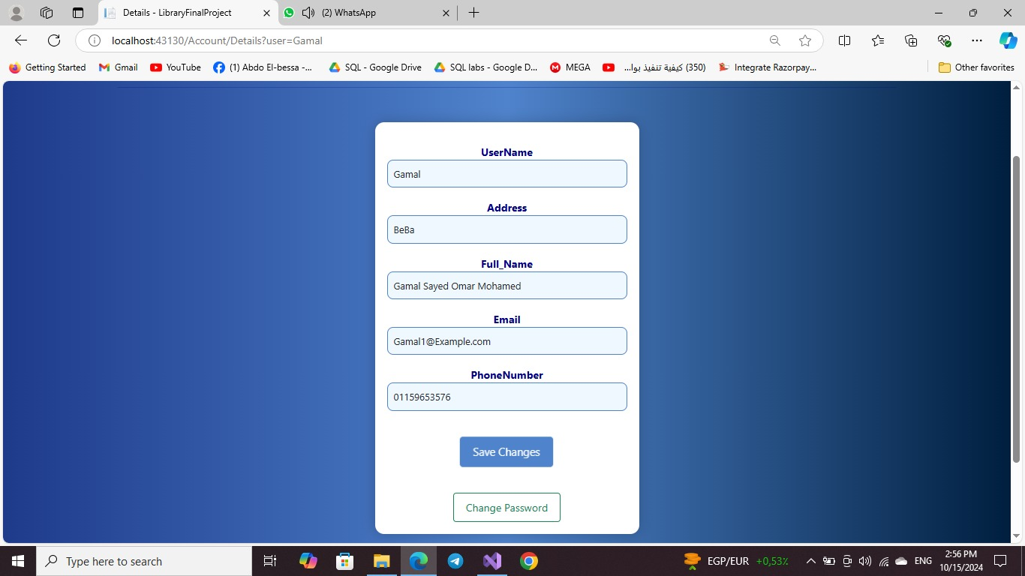
This page belongs to the member himself which enable him to change any of his information datails and resave it after the updates .

Slide 27
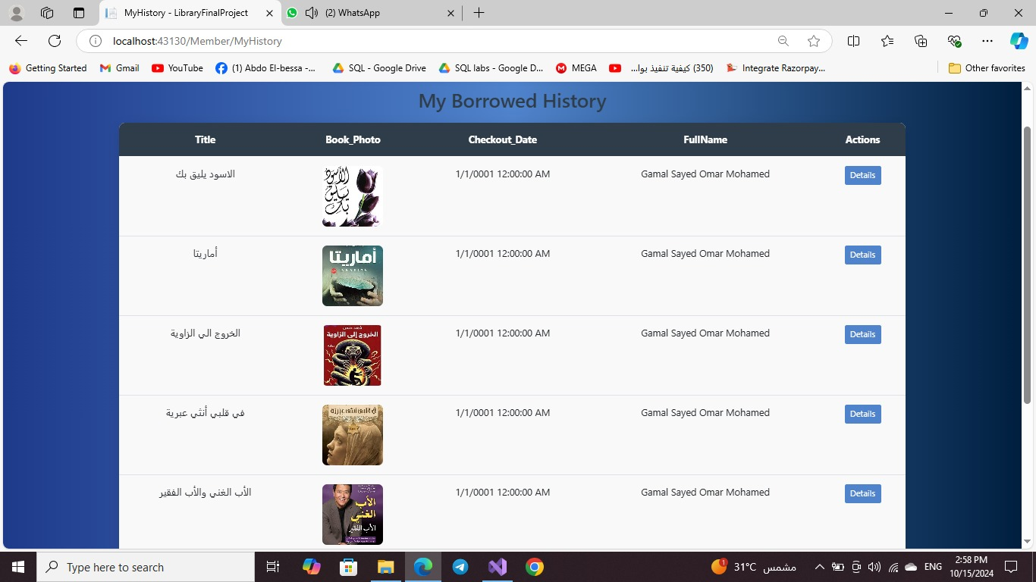
This page display the user’s borrowed history to all books with its details of every book

Slide 28
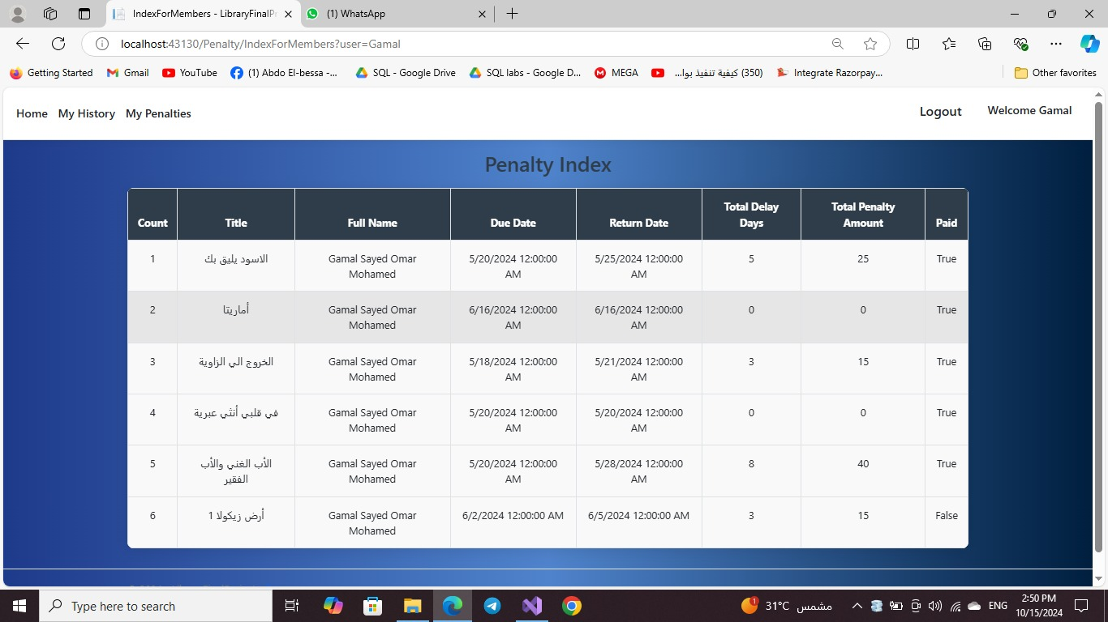
This page display the penalty index of all penaltys that have benn applied on the user himself with its date and details .

Slide 29
Conclusion
The Library Management System with ASP.NET Core successfully streamlines library operations by automating key processes like book checkouts, returns, and penalty calculation. The system provides a comprehensive platform for both librarians and members, enabling effective book management and efficient service delivery. Leveraging modern web technologies such as ASP.NET Core, SQL Server, and Entity Framework, the system ensures scalability, security, and a seamless user experience. With its easy-to-use interface and robust functionality, the system enhances library management, improving both efficiency and the user experience.

Slide 30
Thanks

